Slide 1
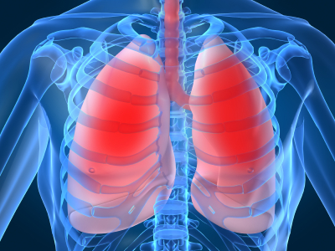
LECTURE NO (2)
Respiratory Physiology BADER HASSAN
Lecturer Of Physiology
Ventilation
Faculty Of Medicine Dept.Of Physiology

Slide 2
Ventilation
Ventilation: is the process of getting air into & out of the lungs during breathing.
It always adjusted to meet the metabolic demands of the body
To provide sufficient O2 & to eliminate excess CO2.

Slide 3
Hperventilation:
Refers to ventilation in excess of the metabolic demands of tissues.
Hypoventilation:
Refers to ventilation less than the metabolic demands of tissues.

Slide 4
Mechanism of ventilation
Air moves into the lungs when the atmospheric pressure is higher than the intrapulmonary pressure (inspiration).
Air moves out of the lungs when the atmospheric pressure is lower than the intrapulmonary pressure (expiration)

Slide 5
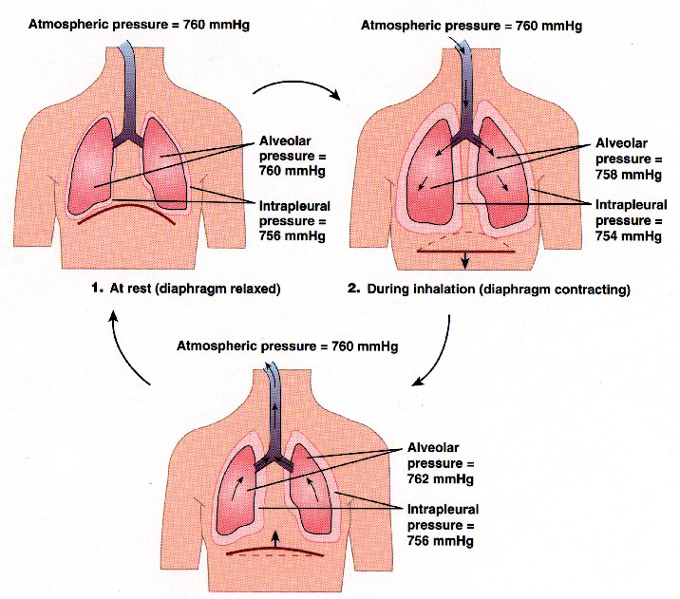

Slide 6
Mechanism of inspiration
Contraction of inspiratory muscles.
Expansion of the chest.
Reduction of intra-pleural pressure.
Expansion of the lungs.
Reduction of intra-pulmonary pressure.
Air moves into the lungs.

Slide 7
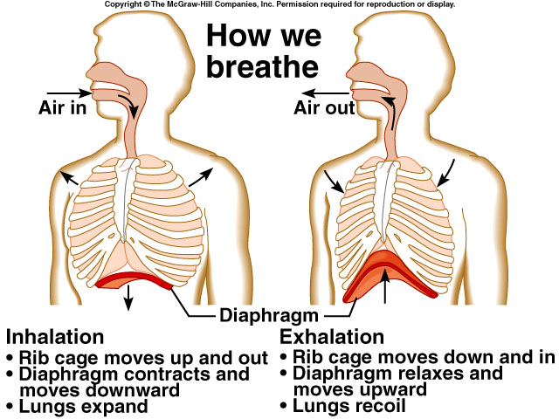

Slide 8
Inspiration is an active process because it involves contraction of inspiratory muscles.
inspiratory muscles at rest are:
The diaphragm.
The external intercostal muscles.
In addition, there are accessory inspiratory muscles working during forced inspiration e.g. during exercise.

Slide 9
Mechanism of expiration
Relaxation of inspiratory muscles.
Increased intrapleural pressure.
Deflation of the lung.
Increased intra-pulmonary pressure.
Air moves out of the lungs.

Slide 11
Expiration at rest is a passive process science it does not involve contraction of any expiratory muscle.
Forced expiration requires the action of the following expiratory muscles:
Internal intercostal muscles.
Abdominal muscles.

Slide 12
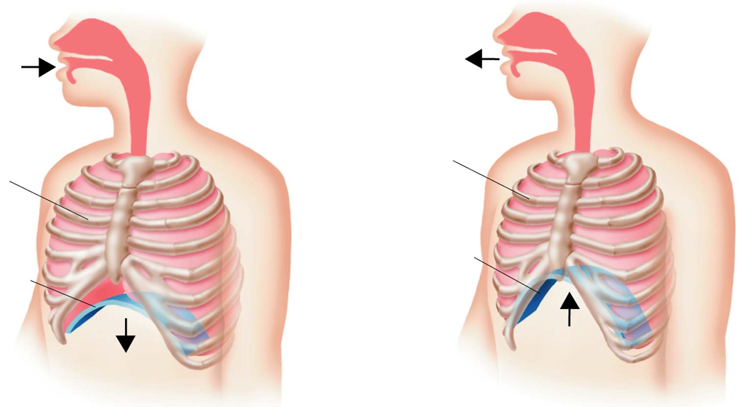
Figure 37-16 The Mechanics of Breathing
Section 37-3
Air inhaled
Air exhaled
Rib cage descends
Rib cage rises
Diaphragm
Diaphragm
Inhalation
Exhalation
Notes:
The diaphragm is a muscle that separates the pleural cavity from the abdominal cavity.
During inhalation, the diaphragm contracts, increasing the size of the chest cavity. The air enters

Slide 13
Figure 37-16 The Mechanics of Breathing
Section 37-3
Air inhaled
Air exhaled
Rib cage descends
Rib cage rises
Diaphragm
Diaphragm
Inhalation
Exhalation
Notes:
Exhalation occurs when the diaphragm relaxes.
Heimlich manuever

Slide 14
Surfactant
A phospholipid substance.
Produced by type II alveolar cells.
Act to reduce the surface tension of fluid in the alveoli.
The surface tension occurs due to cohesive force between water molecules tending to contract the surface of alveoli resulting in their collapse.

Slide 15
Surfactant prevent alveolar collapse.
Production of surfactant starts late in pregnancy after 32nd week of pregnancy.
It is deficient in pre term babies.
These babies develop cyanosis & difficulty in breathing at birth due to alveolar collapse
This was called respiratory distress syndrome (RDS)

Slide 16
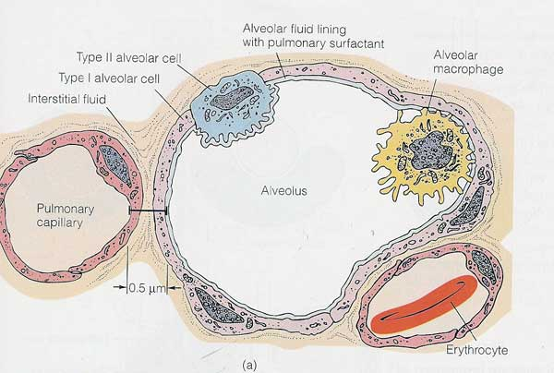

Slide 17


